Slide 1
SQOOP
SQl to hadOOP

Slide 2
Intro
Apache Sqoop is an open source tool that allows users to extract data from a structured data store(RDBMS) into Hadoop for further processing
This processing can be done with MapReduce programs or other higher-level tools such as Hive, Hbase
Sqoop can export these results back to the data store (RDBMS)

Slide 3
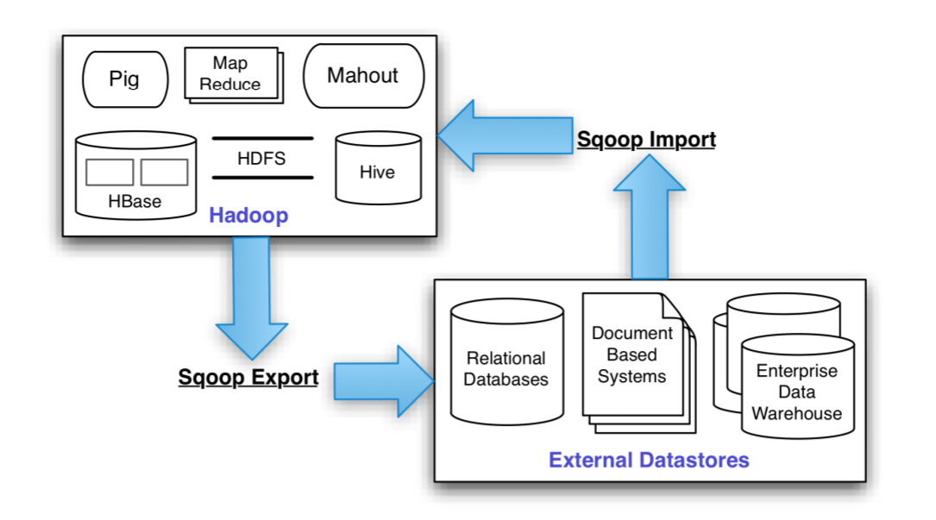
Hadoop Data Processing

Slide 4
Sqoop Connectors
Uses JDBC to connect to the database
Works with virtually all standard RDBMSs
Sqoop ships with connectors for working with a range of popular databases, including MySQL, PostgreSQL, Oracle, SQL Server, DB2, and Netezza(DB specfic API)
There is also a generic JDBC connector for connecting to any database that supports Java’s JDBC protocol.

Slide 5
Import
sqoop import --connect jdbc:mysql://localhost/hadoopguide \ --table myTable -m 1
Sqoop’s import tool will run a MapReduce job that connects to the MySQL database and reads the table.
By default, this will use four map tasks in parallel to speed up the import process. Each task will write its imported results to a different file, but all in a common directory

Slide 6
Import
hadoop fs -cat myTable/part-m-00000
By default, Sqoop will generate comma-delimited text files for our imported data.
command-line arguments that specify delimiter characters, file formats, compression, and more fine-grained con‐ trol of the import process

Slide 7
Generated Code
Sqoop also provides you with a generated Java source file (myTable.java) written to the current local directory.
handle the deserialization of table-specific data from the database source
sqoop codegen --connect jdbc:mysql://localhost/hadoopguide \ --table myTable--class-name myTable

Slide 8
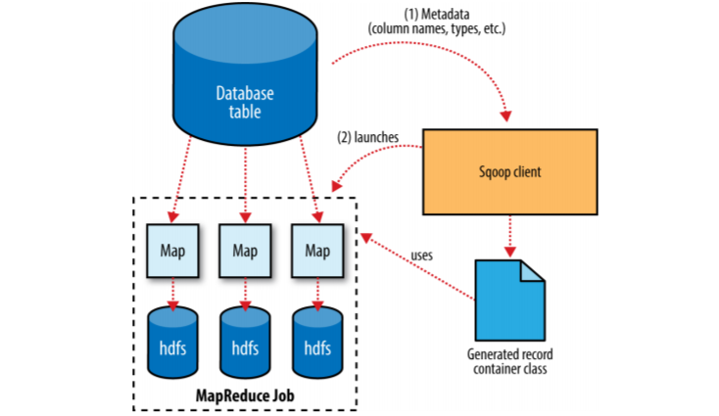
Import In Action

Slide 9
Import in Action
Sqoop is written in Java. Java provides an API called Java Database Connectivity, or JDBC, that allows applications to access data stored in an RDBMS
database provide JDBC driver that implements the JDBC API and contains the necessary code to connect to their database servers.
Sqoop uses JDBC to examine the table it is to import
It retrieves a list of all the columns and their SQL data types.
Sqoop’s code generator will use this information to create a table-specific class to hold a record extracted from the table.

Slide 10
Import in Action
public void readFields(ResultSet __dbResults) throws SQLException;
public void write(PreparedStatement __dbStmt) throws SQLException;
DataDrivenDBInputFormat provided with Ha‐ doop partitions a query’s results over several map tasks
import performance can be gained by dividing this query across mul‐tiple nodes by using a splitting column

Slide 11
Import in Action
Using metadata about the table, Sqoop will guess a good column to use for splitting the table (typically the primary key for the table, if one exists).
The minimum and maximum values for the primary key column are retrieved, and then these are used in conjunction with a target number of tasks to determine the queries that each map task should issue.
Users can specify a particular splitting column when running an import job (via the --split-by argument)

Slide 12
Import an Entire Table
sqoop import \ --connect jdbc:mysql://mysql.example.com/sqoop \ --username sqoop \ --password sqoop \ --table cities
The result of this command will be a comma-separated CSV file where each row is stored in a single line.

Slide 13
Specifying a Target Directory
sqoop import \ --connect jdbc:mysql://mysql.example.com/sqoop \ --username sqoop \ --password sqoop \ --table cities \ --target-dir /etl/input/cities
sqoop import \ --connect jdbc:mysql://mysql.example.com/sqoop \ --username sqoop \ --password sqoop \ --table cities \ --warehouse-dir /etl/input/

Slide 14
Import Subset of Data
sqoop import \ --connect jdbc:mysql://mysql.example.com/sqoop \ --username sqoop \ --password sqoop \ --table cities \ --where "country = 'USA'“
sqoop import \ --connect jdbc:mysql://mysql.example.com/sqoop \ --username sqoop \ --password sqoop \ --query 'SELECT normcities.id, \ countries.country, \ normcities.city \ FROM normcities \ JOIN countries USING(country_id) \ WHERE $CONDITIONS' \ --split-by id \ --target-dir cities

Slide 15
Protecting Your Password
sqoop import \ --connect jdbc:mysql://mysql.example.com/sqoop \ --username sqoop \ --table cities \ -P
sqoop import \ --connect jdbc:mysql://mysql.example.com/sqoop \ --username sqoop \ --table cities \ --password-file my-sqoop-password

Slide 16
Other Formats
sqoop import \ --connect jdbc:mysql://mysql.example.com/sqoop \ --username sqoop \ --password sqoop \ --table cities \ --as-sequencefile
sqoop import \ --connect jdbc:mysql://mysql.example.com/sqoop \ --username sqoop \ --password sqoop \ --table cities \ --as-avrodatafile

Slide 17
Controlling Parallelism
sqoop import \ --connect jdbc:mysql://mysql.example.com/sqoop \ --username sqoop \ --password sqoop \ --table cities \ --num-mappers 10

Slide 18
Incremental Imports
sqoop import \ --connect jdbc:mysql://mysql.example.com/sqoop \ --username sqoop \ --password sqoop \ --table visits \ --incremental append \ --check-column id \ --last-value 1
sqoop import \ --connect jdbc:mysql://mysql.example.com/sqoop \ --username sqoop \ --password sqoop \ --table visits \ --incremental lastmodified \ --check-column last_update_date \ --last-value "2013-05-22 01:01:01“
sqoop job --exec visits
sqoop job --show visits

Slide 19
Custom Boundary Queries
sqoop import \ --connect jdbc:mysql://mysql.example.com/sqoop \ --username sqoop \ --password sqoop \ --query 'SELECT normcities.id, \ countries.country, \ normcities.city \ FROM normcities \ JOIN countries USING(country_id) \ WHERE $CONDITIONS' \ --split-by id \ --target-dir cities \ --boundary-query "select min(id), max(id) from normcities"

Slide 20
Hive Import
sqoop import --connect jdbc:mysql://localhost/hadoopguide \ > --table myTable -m 1 --hive-import
Running sqoop import with the --hive-import argument will load the data directly from the source database into Hive;
it infers a Hive schema automatically based on the schema for the table in the source database

Slide 21
Export
an export uses HDFS as the source of data and a remote database as the destination.
sqoop export --connect jdbc:mysql://localhost/hadoopguide -m 1 \ --table sales_by_zip --export-dir /user/hive/warehouse/zip_profits \ --input-fields-terminated-by '\0001'

Slide 22
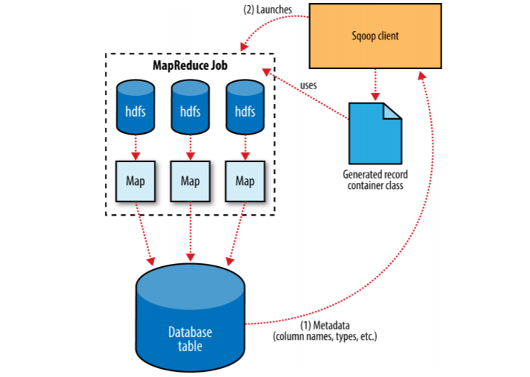
Export In Action

Slide 23
Export In Action
Sqoop will spawn multiple tasks to export slices of the data in parallel.
Due to the parallel nature of the process, often an export is not an atomic operation.
Sqoop commits results every few thousand rows, to ensure that it does not run out of memory
Sqoop can export to a temporary staging table and then, at the end of the job—if the export has succeeded—move the staged data into the destination table in a single transaction.
--clear-staging-table, staging table must already exist and must also be empty

